Slide 1






PAI CA1
Group 1
Shaun Kwo - P2317933
Loh Yip Khai - P2317454
Koh Zi Hao - P2317483

Slide 2



Agenda
KEY TOPICS DISCUSSED IN THIS PRESENTATION
Introduction Our Objective Data Cleaning and Preprocessing Database Creation & SQL Queries ETL pipeline Exploratory Data Analysis Interactive Tableau Dashboard Conclusion

Slide 3

SP-Buy Fraud Detection Analysis
We are a SCRUM team working in SP-buy development
With:
- Yip Khai as the ETL Pipeline Developer and Data Analyst,
- Zi Hao as the SQL Database Setup and Data Analyst
- Shaun as the Data Scientist

Slide 4

Our Objective
Our objective is to:
Help us gain a better understanding of the data science project workflow,
including creating SQL database for data storage, setting up data pipeline between SQL and Python,
using Python for data analysis and
building an interactive dashboard for business users.

Slide 5
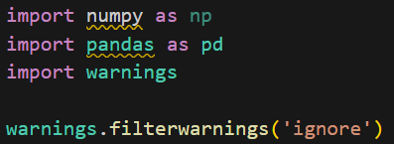
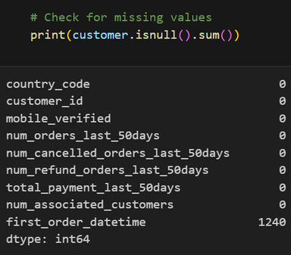
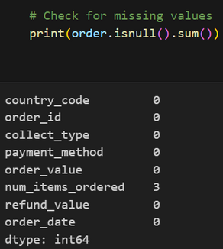
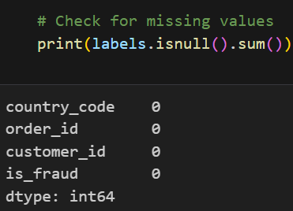
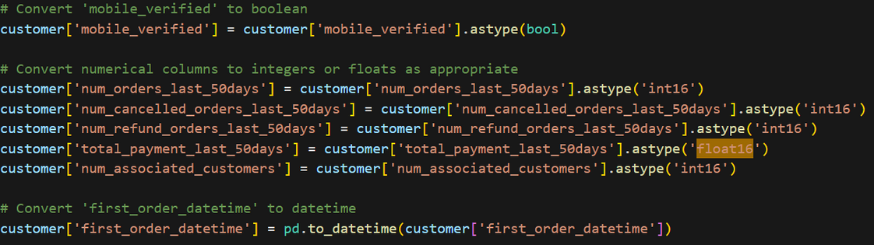
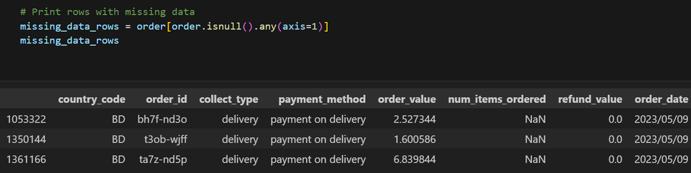
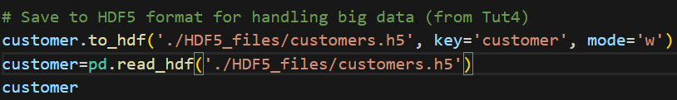
Data Cleansing and Preprocessing
Importing Libraries and Datasets
Step 4: Checking for Missing Values
Step 1: Remove additional Spacing and \n from data
For first_order_datetime, we did not remove it as it has no impact on data analysis or the dashboard we decided to leave it without removing the rows .
Display Rows with missing num_items_ordered
Step 2: Shrinking numerical dtype (64-> 16)
Step 3: Save to HDF5 files format (faster data processing)

Slide 6
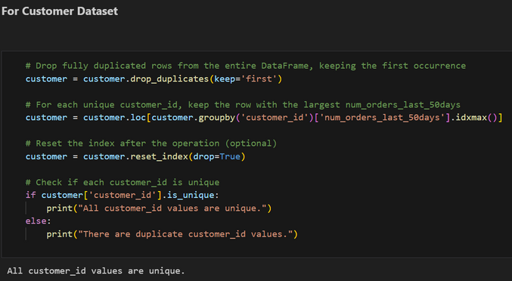
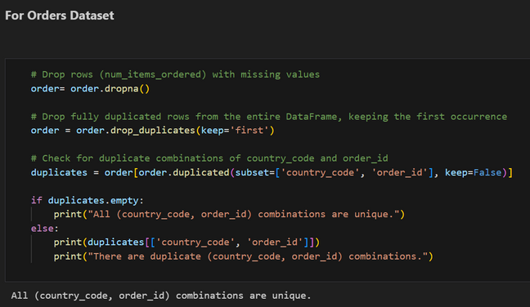
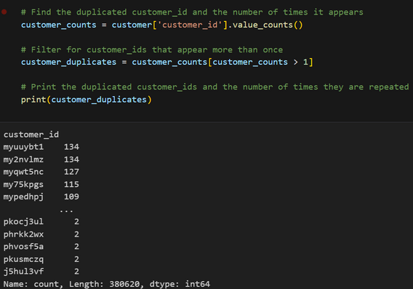
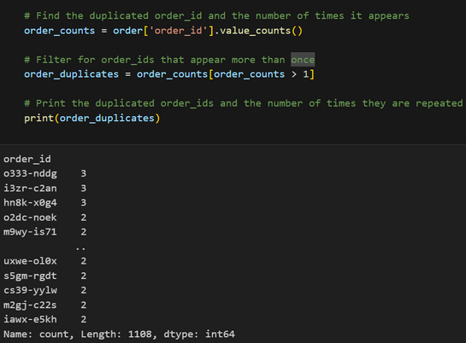
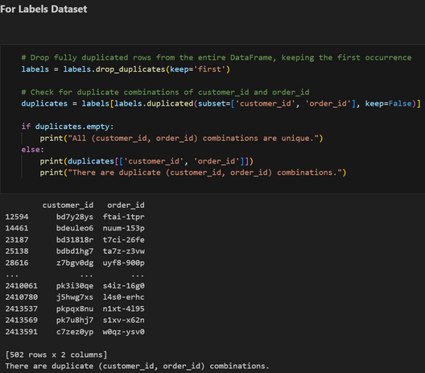
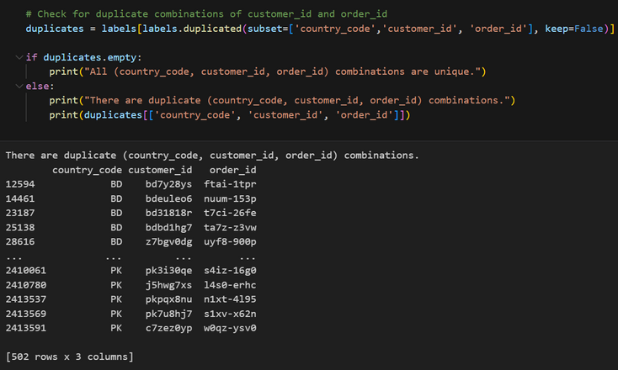
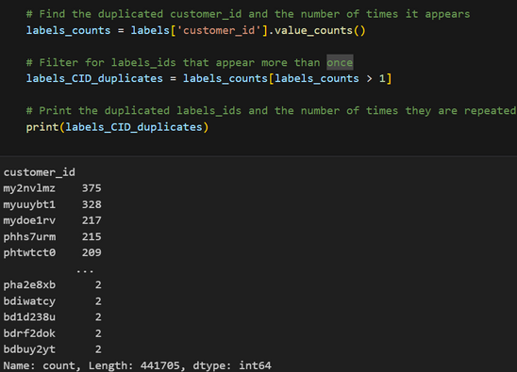
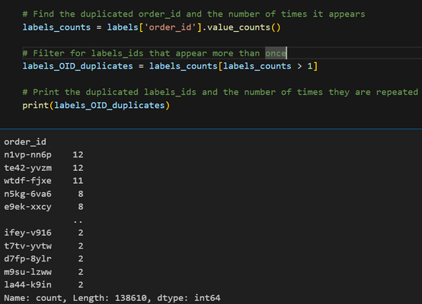
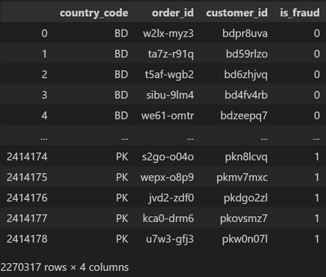
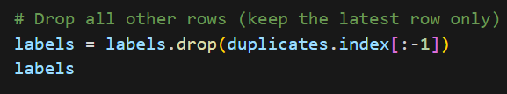
Data Cleansing and Preprocessing
Step 6: Data Cleansing, Preprocessing and
Entity Integrity Rule Checking
Step 5: Checking for Duplicated Rows
Solution for removing duplicated rows of (customer_id, order_id)
Observation: All datasets have entirely duplicated rows so we will have to deal with it.

Slide 7
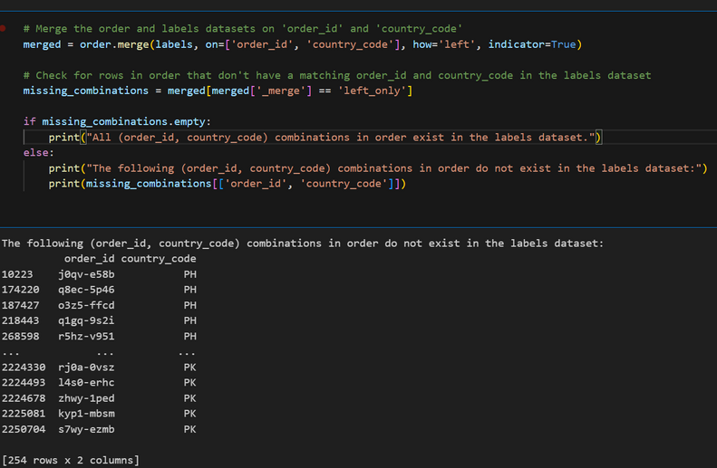
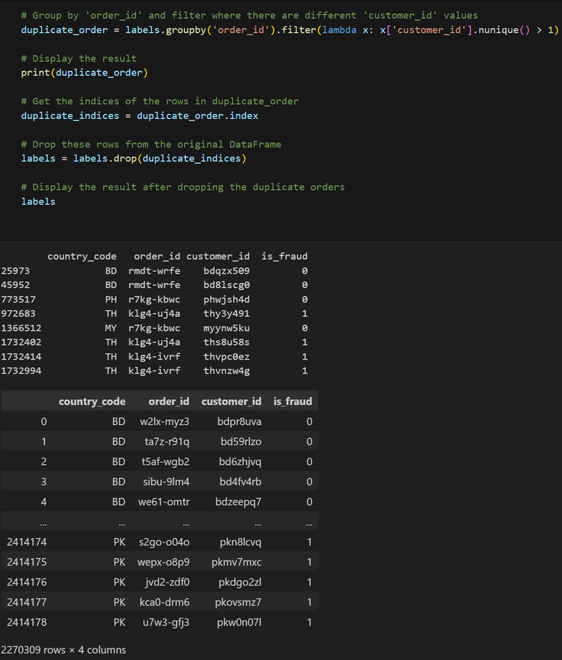
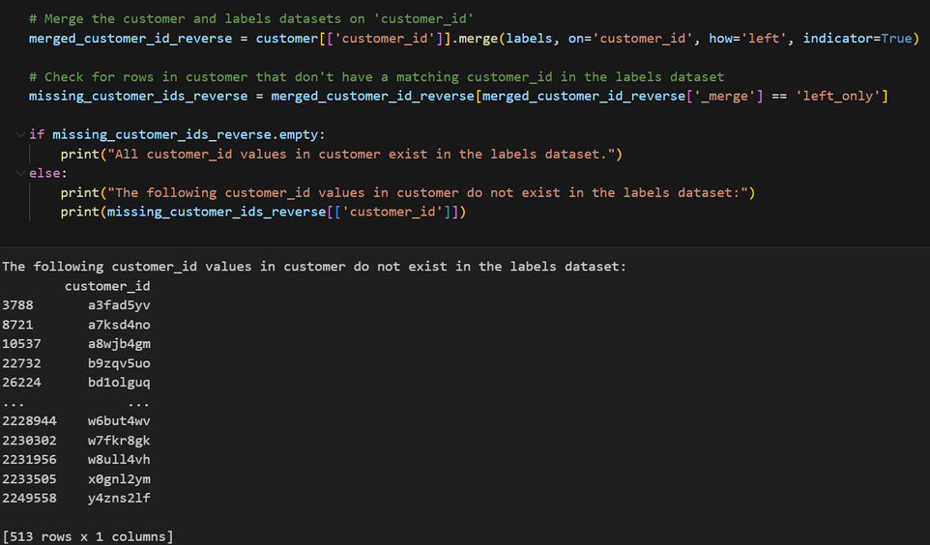
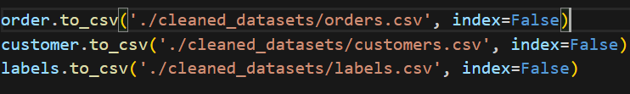
Data Cleansing and Preprocessing
Step 7: Check for and remove records with duplicated order_id
Step 8: Check if all PKs exists without duplicates
Step 9: Saving Cleaned Datasets as CSV

Slide 8
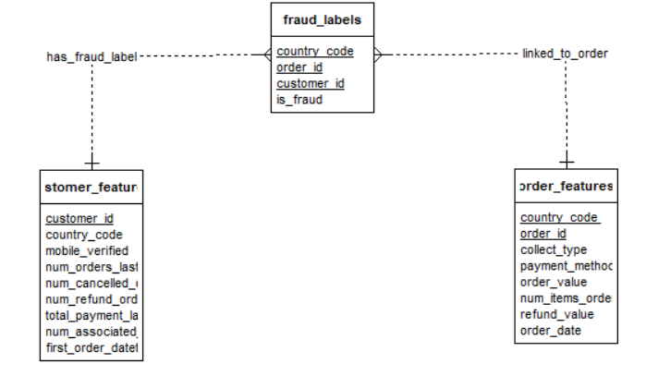
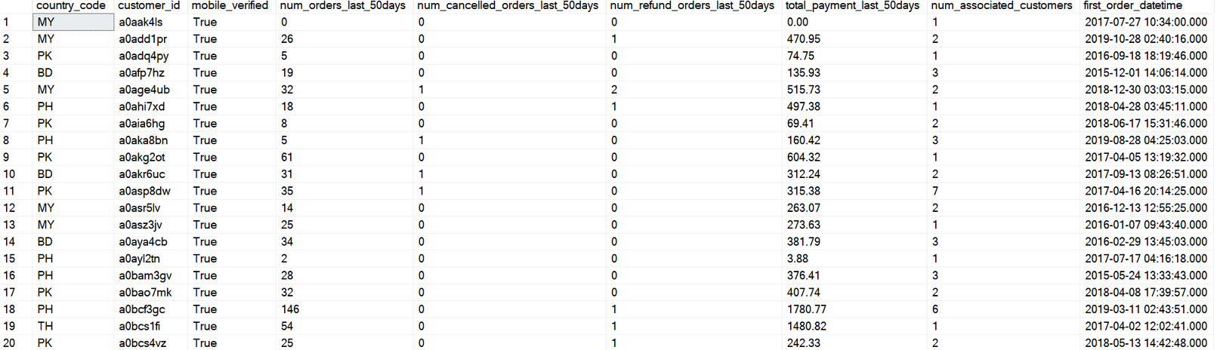
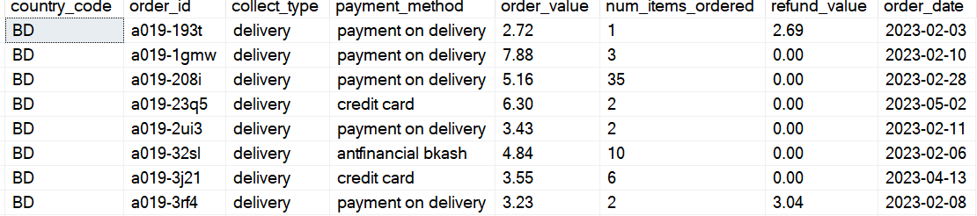
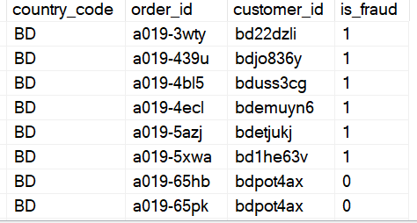
Database Creation
ER Diagram:
customer_features Table:
order_features Table:
fraud_labels Table:

Slide 9
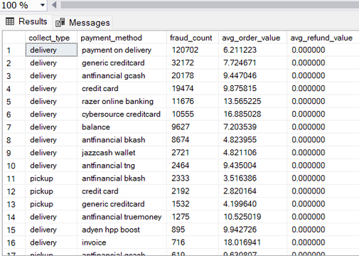
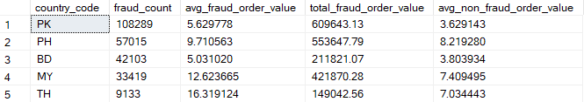
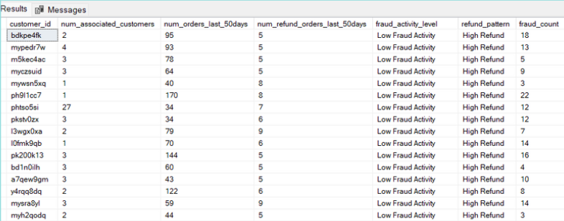
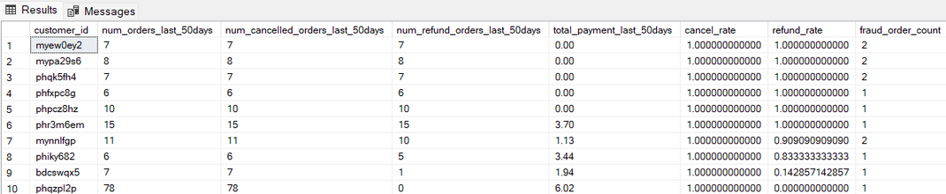
Database Creation
Listing the countries with the highest fraud incidents, along with the average and total order values for fraud and non-fraud cases.
Identifying the most common collection types and payment methods in fraud cases.
identifying top 10 customers with the highest cancel_rate, refund_rate, and fraud_order_count, in their recent order history, potentially signaling fraudulent behavior
Classifying Customers by fraud activity level

Slide 10
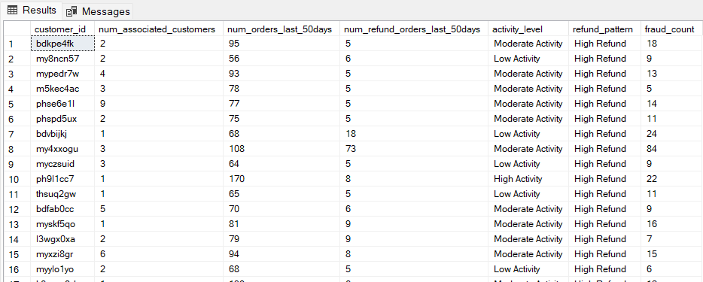
Database Creation
This table highlights fraud insights by country. PK has the highest fraud count (108,289) but lower average fraudulent order values (5.63). TH has fewer fraud cases (9,133) but the highest average fraudulent order value (16.32). Other countries like PH and MY show moderate fraud counts with significant value differences between fraudulent and non-fraudulent orders.
Fraud is most common in delivery with payment on delivery (120,702 cases, avg. value 6.21) and credit cards (pickup: 2,192 cases, avg. value 2.82). Invoices have the highest avg. order values (delivery: 18.02, pickup: 11.40).
The data identifies customers with high cancellation (cancel rate = 100%) and refund rates (refund rate = 100%), potentially indicating fraudulent behavior. Most have all orders canceled or refunded, with fraud order counts ranging from 1 to 2.
Classifying customers by their activity level

Slide 11
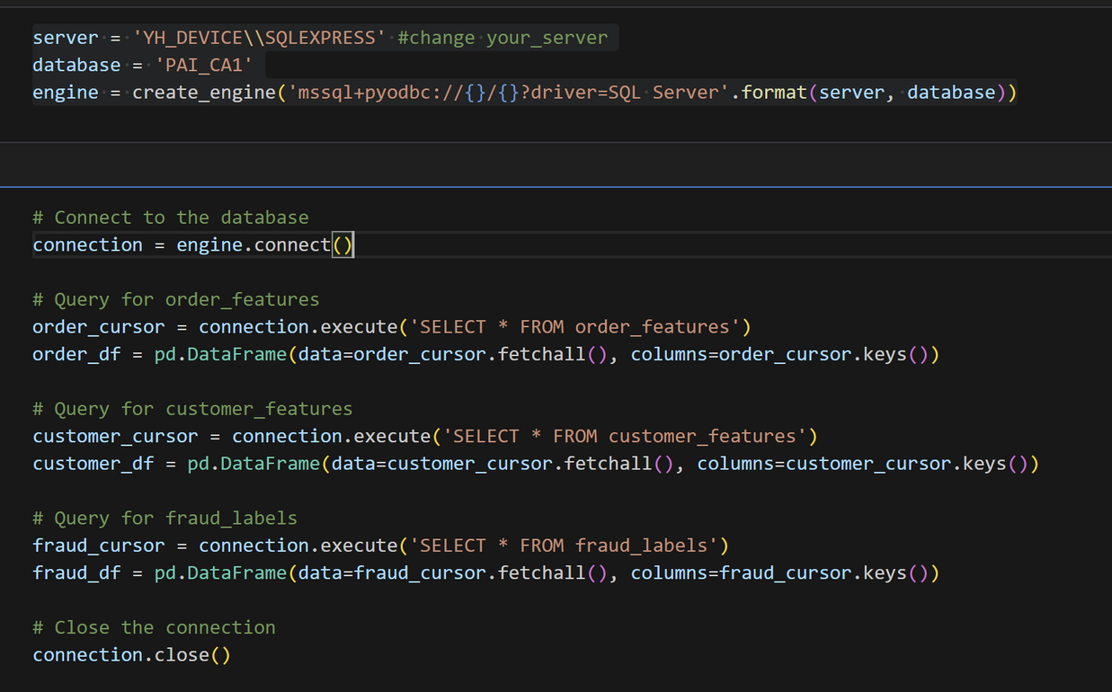
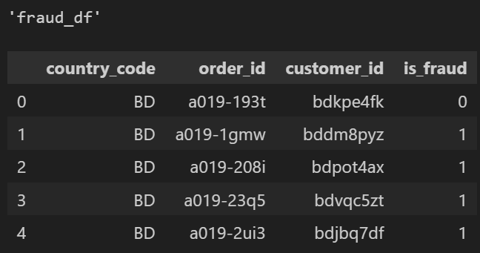
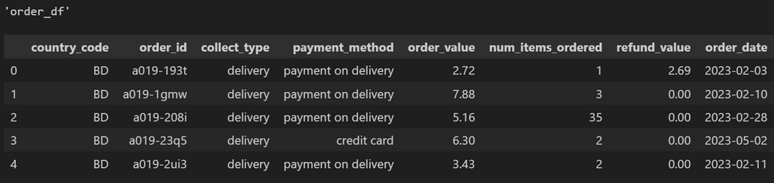
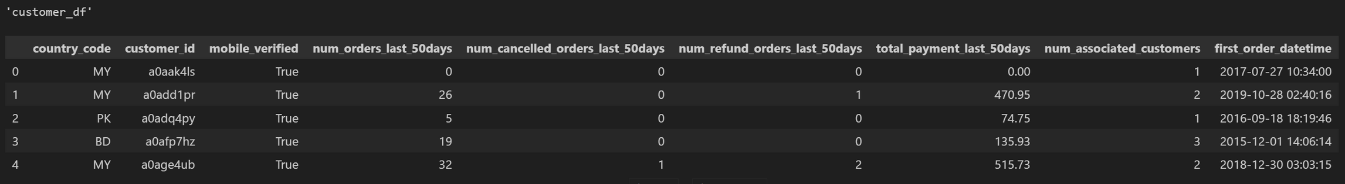
ETL Pipeline

Slide 12
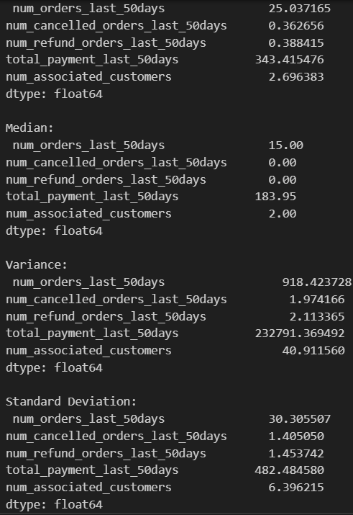
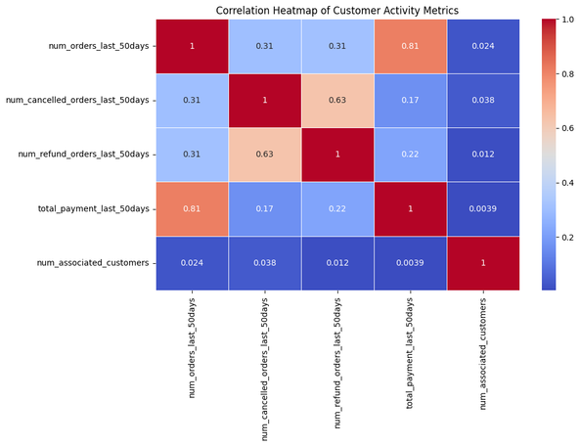
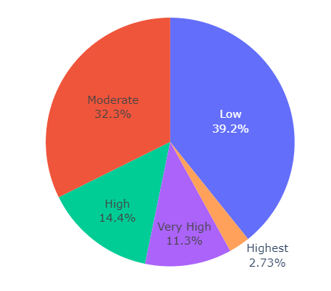
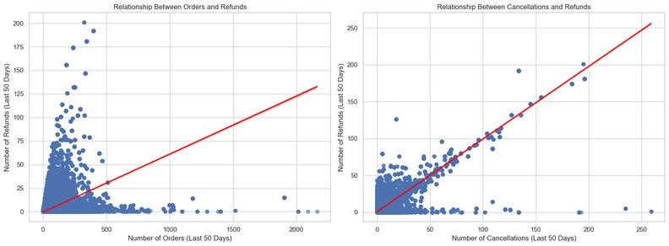
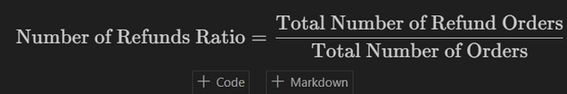
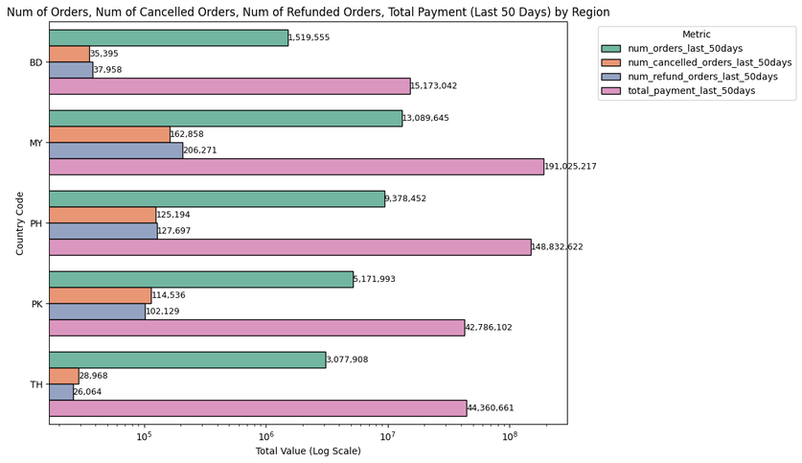
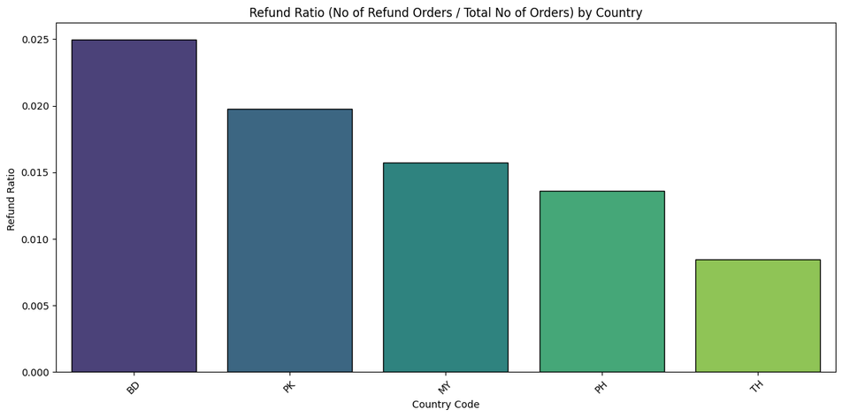
Exploratory Data Analysis (EDA)
For Customer dataset

Slide 13
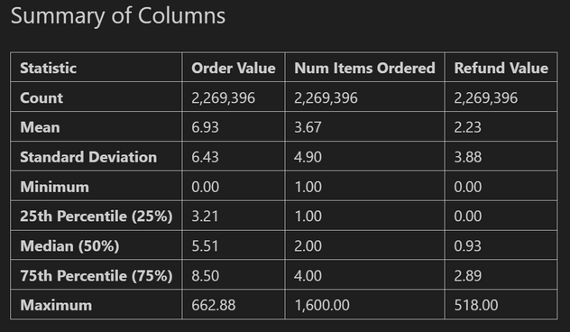
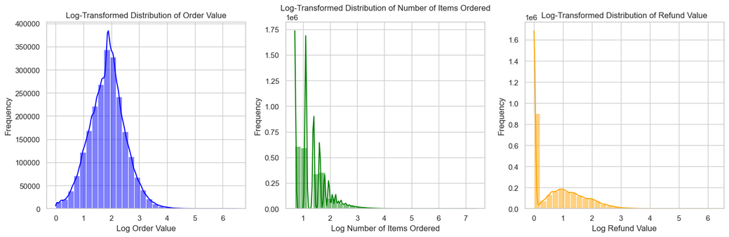
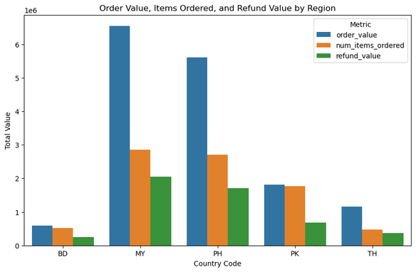
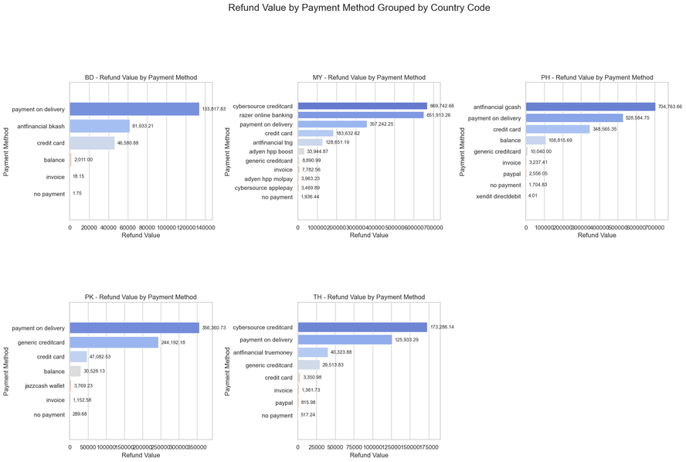
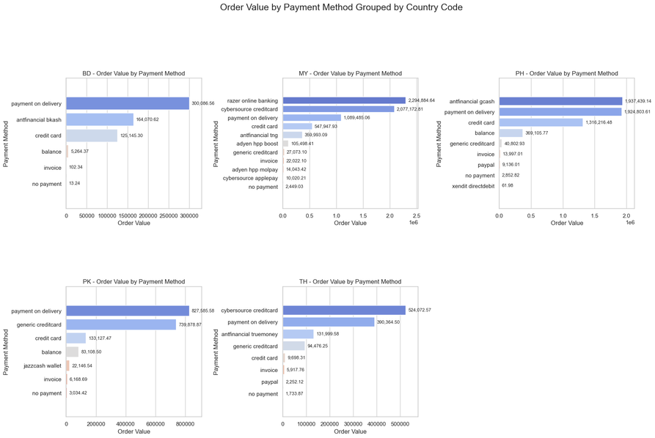
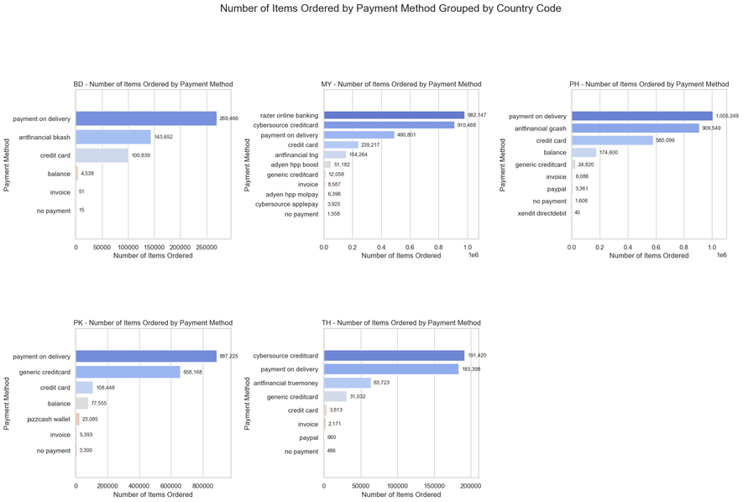
Exploratory Data Analysis
EDA for Order

Slide 14
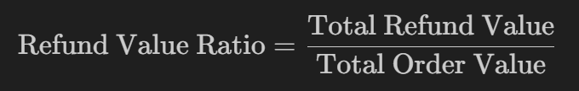
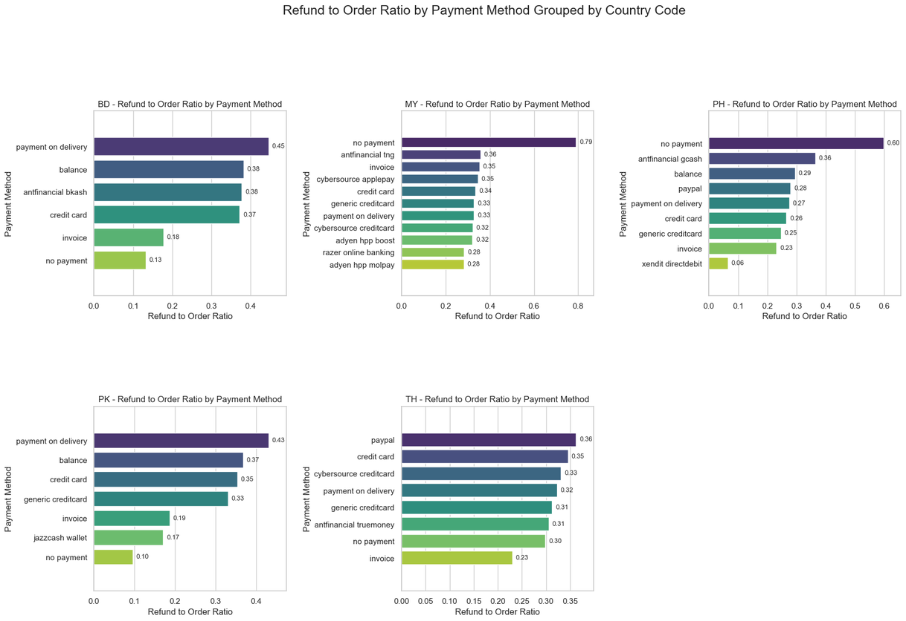
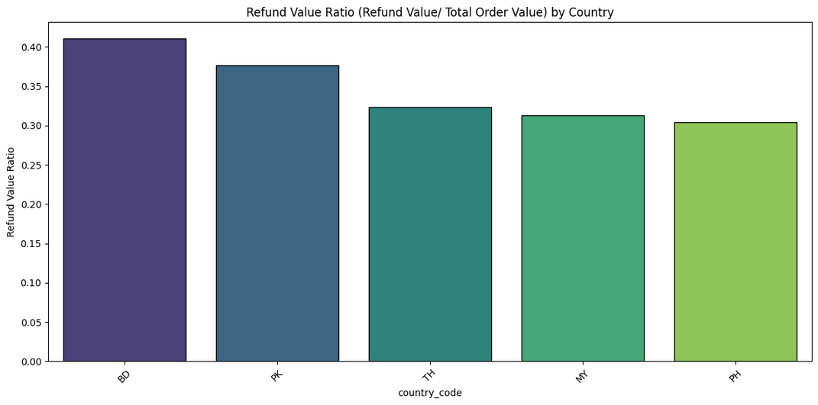
Exploratory Data Analysis
EDA for Order

Slide 15

Exploratory Data Analysis
EDA for Fraud Label

Slide 16

Interactive Tableau Dashboard

Slide 17
Conclusion
Technical Skills
SQL Proficiency:
Expertise in designing relational databases, writing complex queries, and implementing schemas.
Skilled in creating ER diagrams for real-world datasets.
ETL Workflow:
Built ETL pipelines for seamless data transfer between SQL and Python.
Proficient in Python libraries like pandas, SQLAlchemy, and pyodbc.
Data Preprocessing and Analysis:
Mastered data cleaning techniques to address missing values, outliers, and inconsistencies.
Conducted exploratory data analysis (EDA) to detect fraudulent patterns.
Created visualizations using Seaborn and Matplotlib to communicate insights.
Interactive Dashboards:
Experienced in Tableau/Power BI for building actionable and user-friendly dashboards.
Project Management
Agile Methodology:
Practiced Agile workflows with user stories, sprints, and scrum meetings.
Team Collaboration:
Strengthened teamwork through task delegation and effective communication.
Time Management:
Balanced academic and project goals using disciplined scheduling and realistic goal setting.
Fraud Analysis Insights
Fraud Pattern Identification:
Detected fraud indicators like refund rates, cancellations, and payment anomalies.
Leveraged behavioral and transactional data for comprehensive fraud detection.
Data-Driven Decisions:
Supported fraud mitigation through data insights integrated into business strategies.
Lessons Learned
Data Quality:
Highlighted the critical role of data quality in accurate analysis and model performance.
Collaboration:
Understood the importance of effective teamwork in achieving project success.
Iterative Improvement:
Appreciated iterative refinement for enhancing analysis and outputs.
End-to-End Workflow:
Gained comprehensive knowledge of the data science workflow, from database creation to dashboard deployment.

